Slide 1

Jun Lei's Marketing
Presenter: Jinshuai Yu

Slide 2


Slide 3
CONTENTS
01
Showing weakness as a strong person
02
Desperate-Level Launch Event
03
04
Making people perceive the selling points
Price Expectation

Slide 4
Showing weakness as a strong person
01

Slide 5
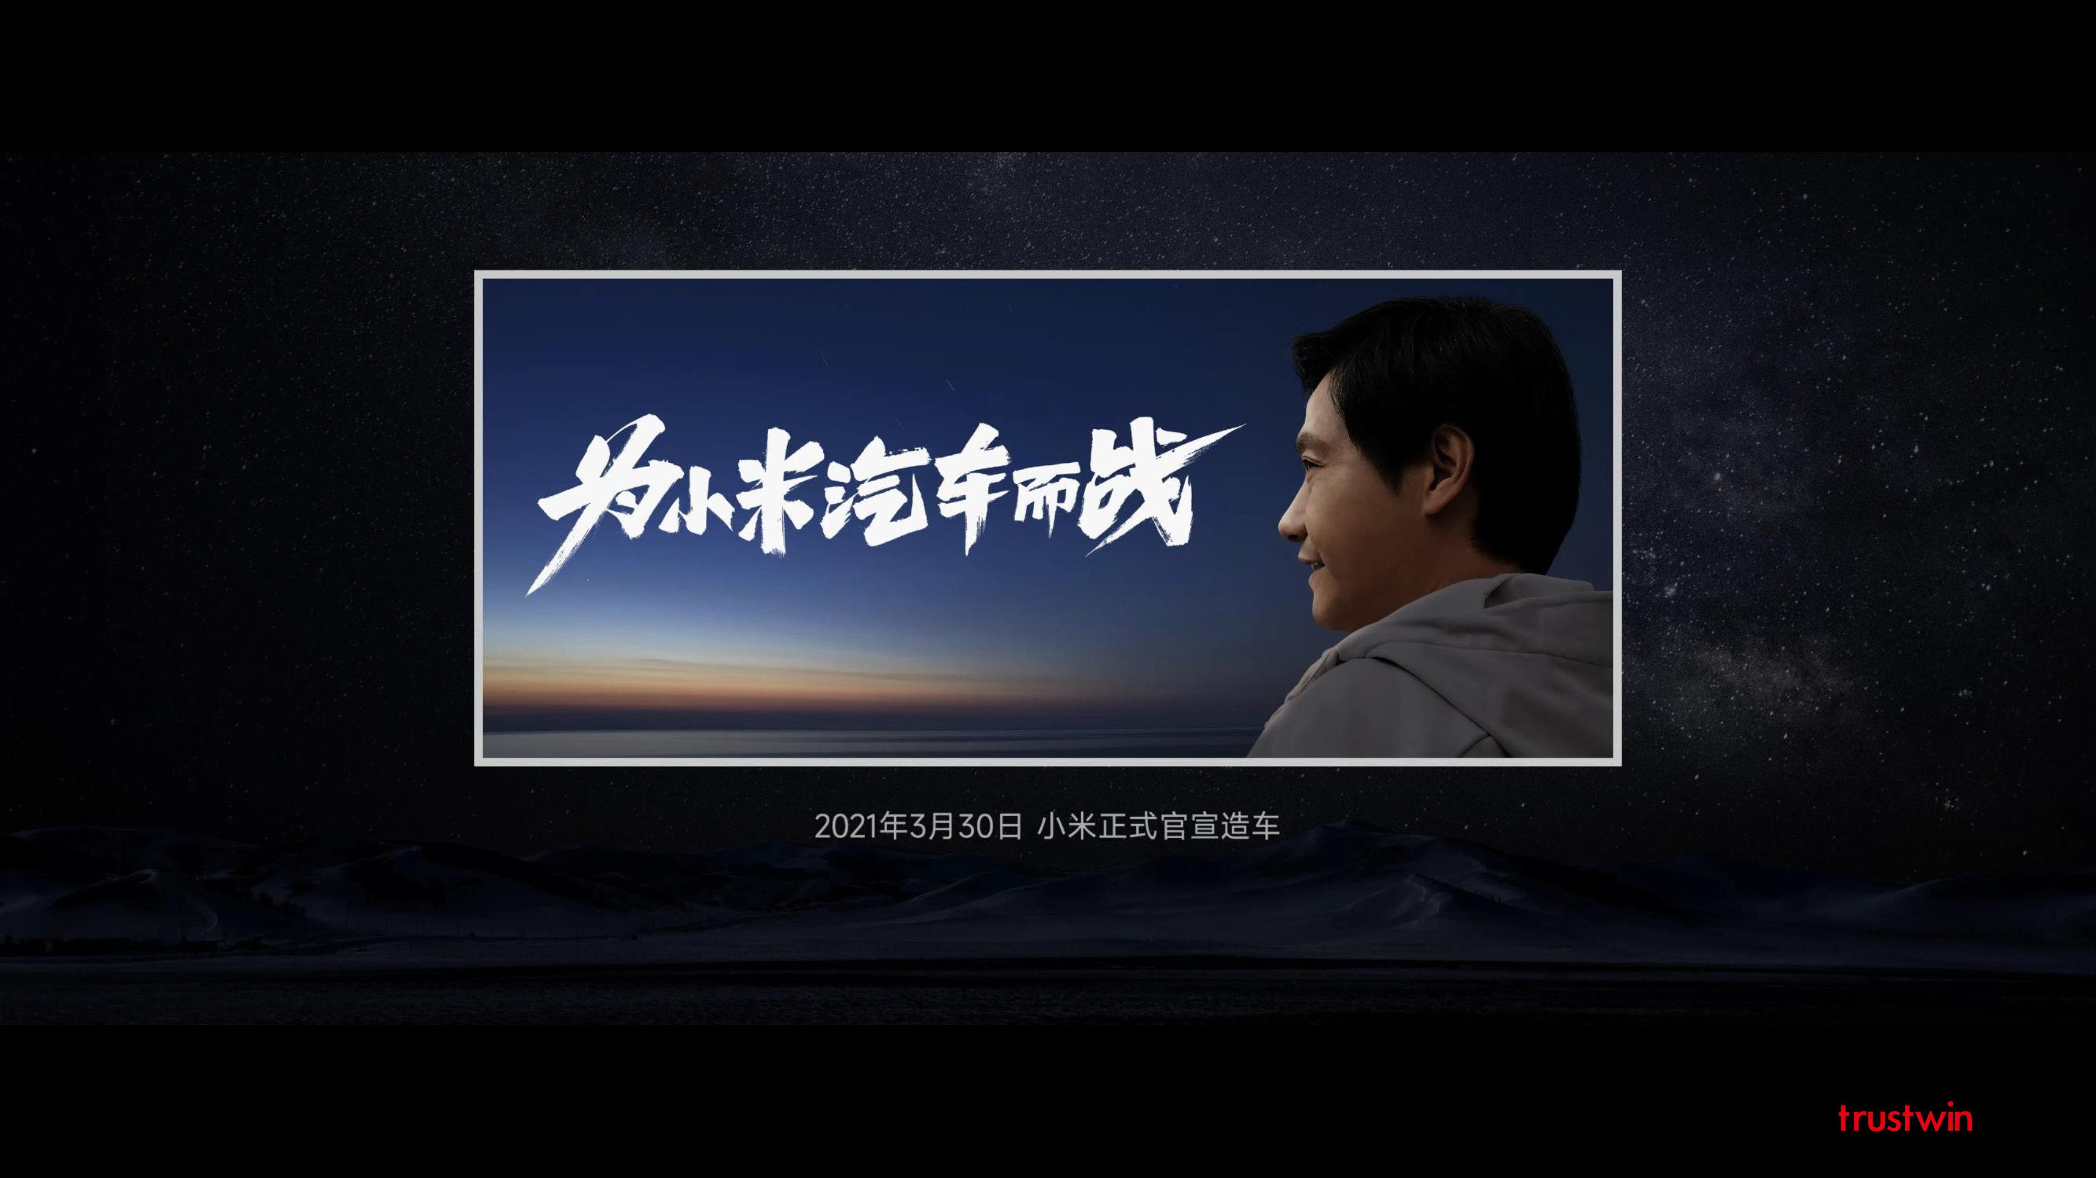
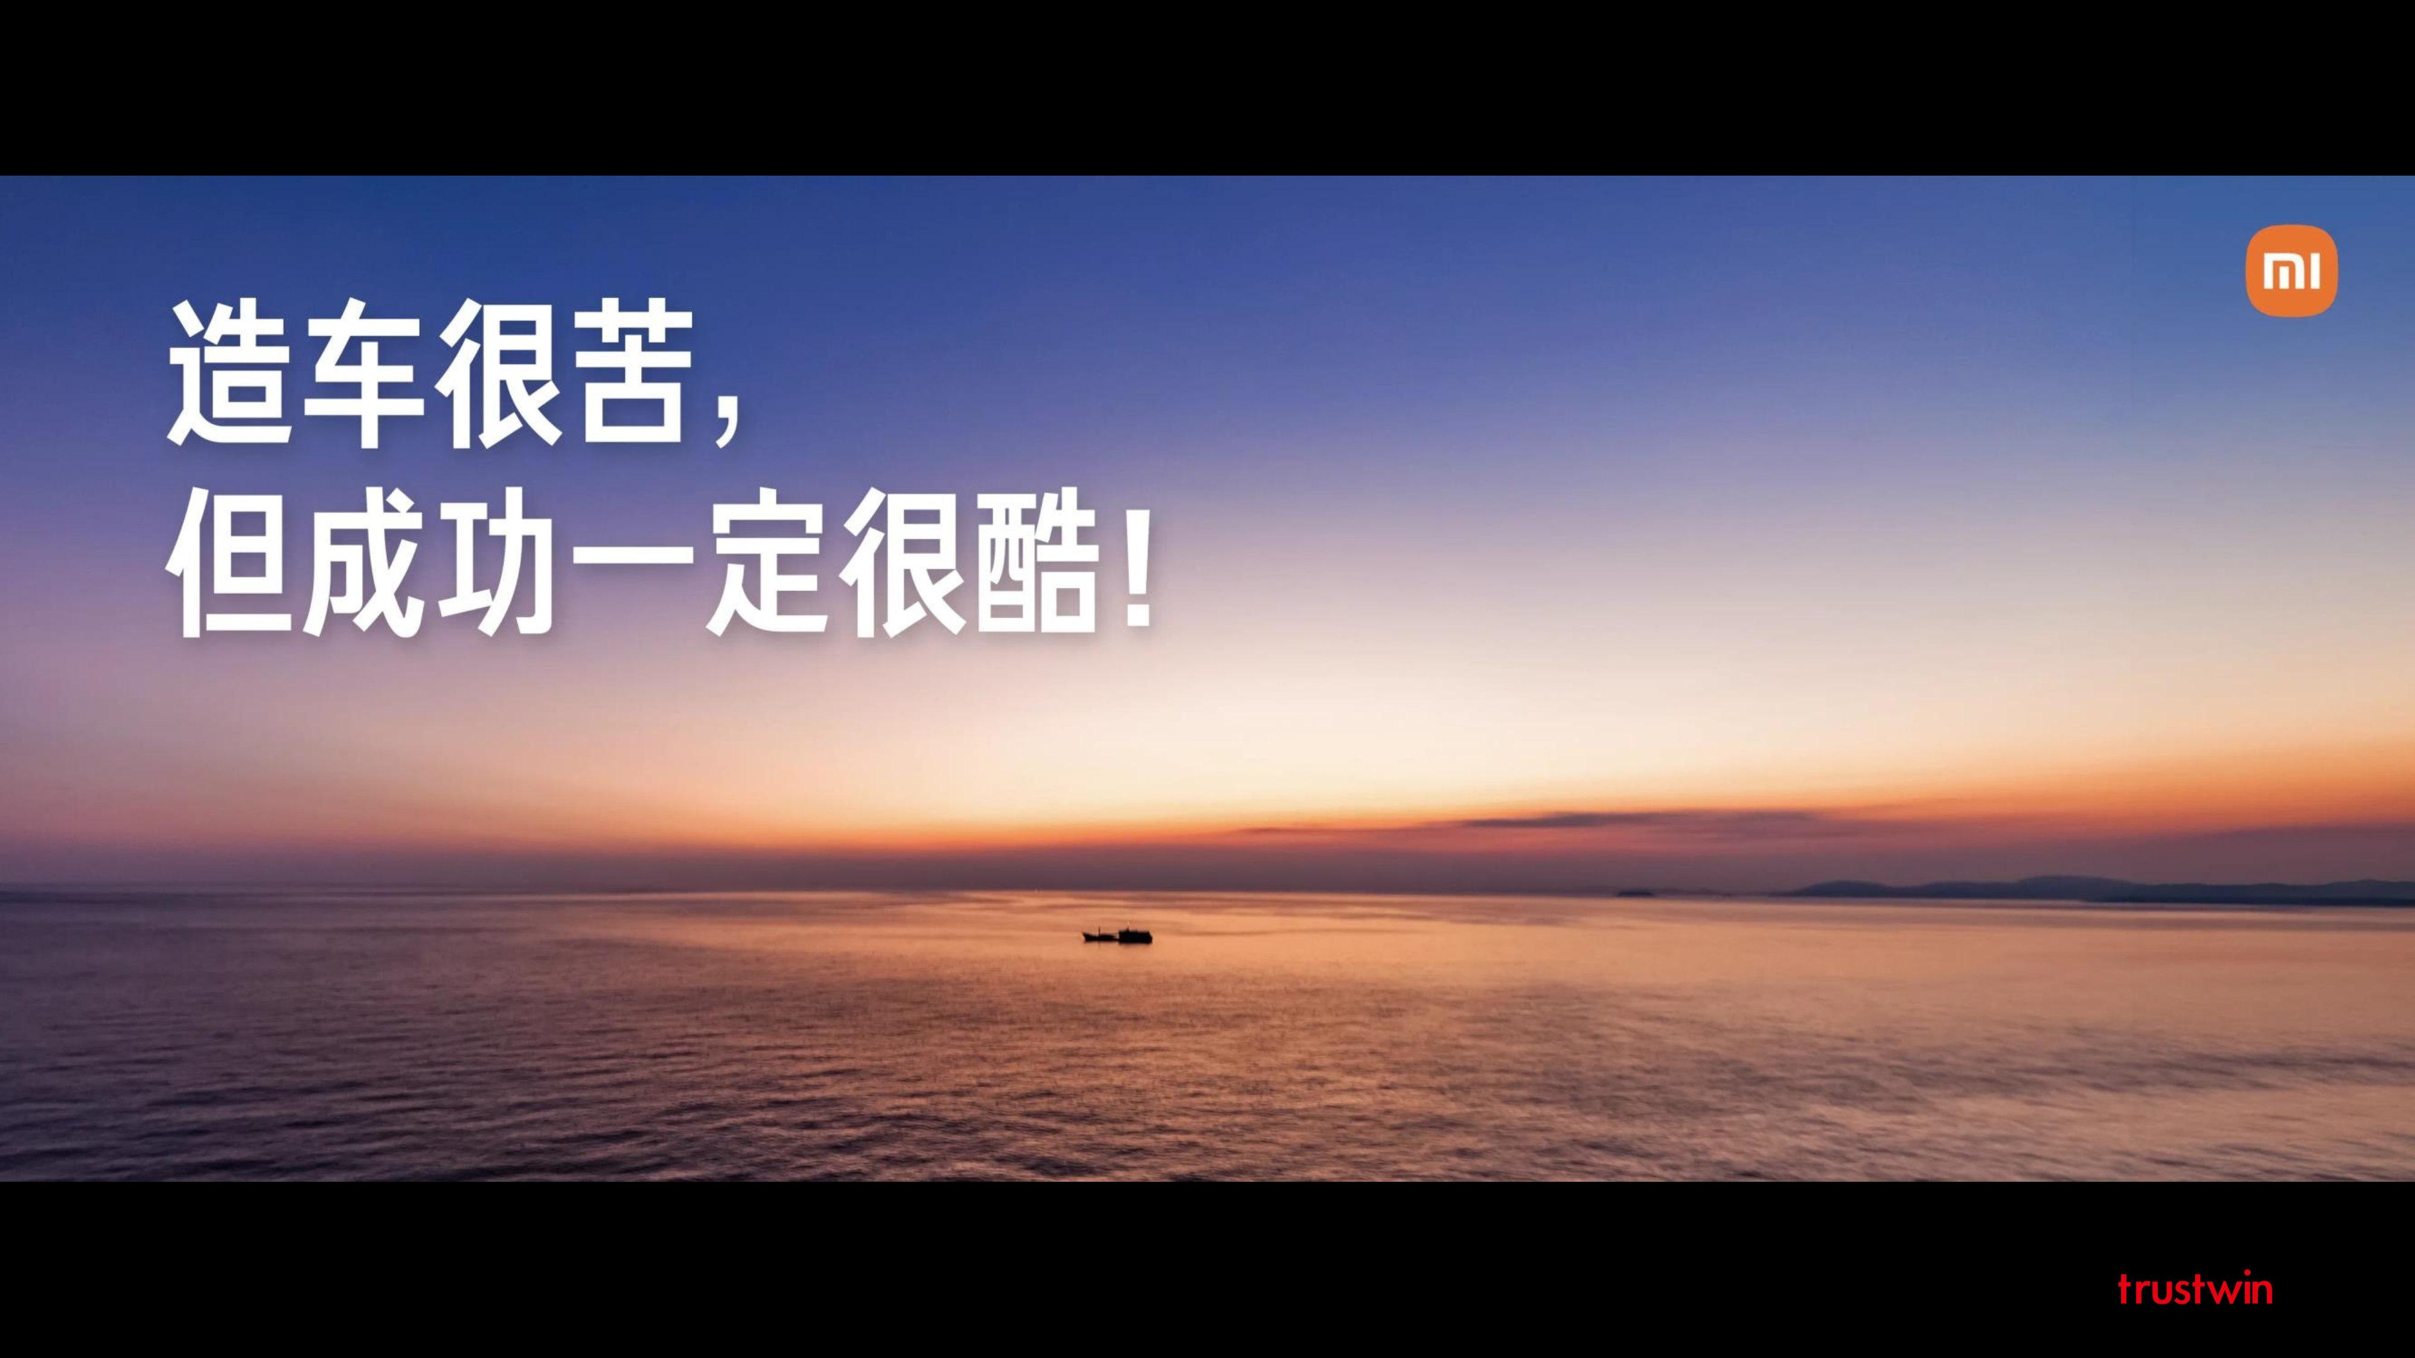
Showing weakness as a strong person
The past three years of car-making have been nerve-wracking every day
Car-making is really too difficult

Slide 6
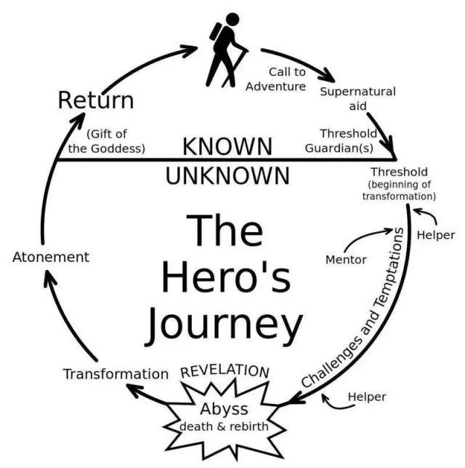

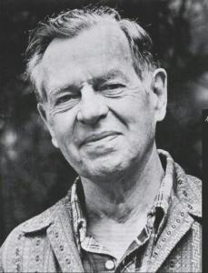
Showing weakness as a strong person
significant challenges
Failures
self-exploration

Slide 7
Desperate-Level Launch Event
02

Slide 8
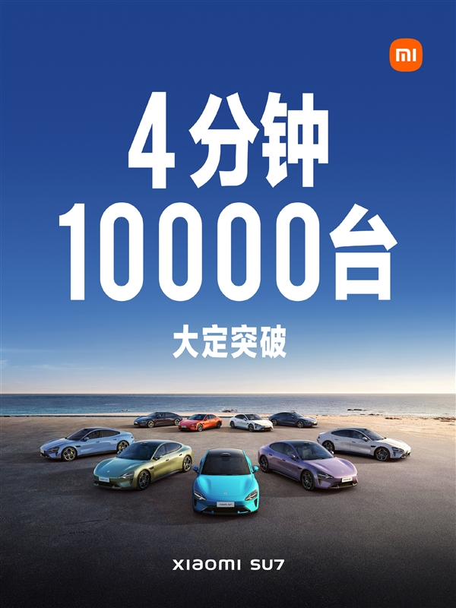
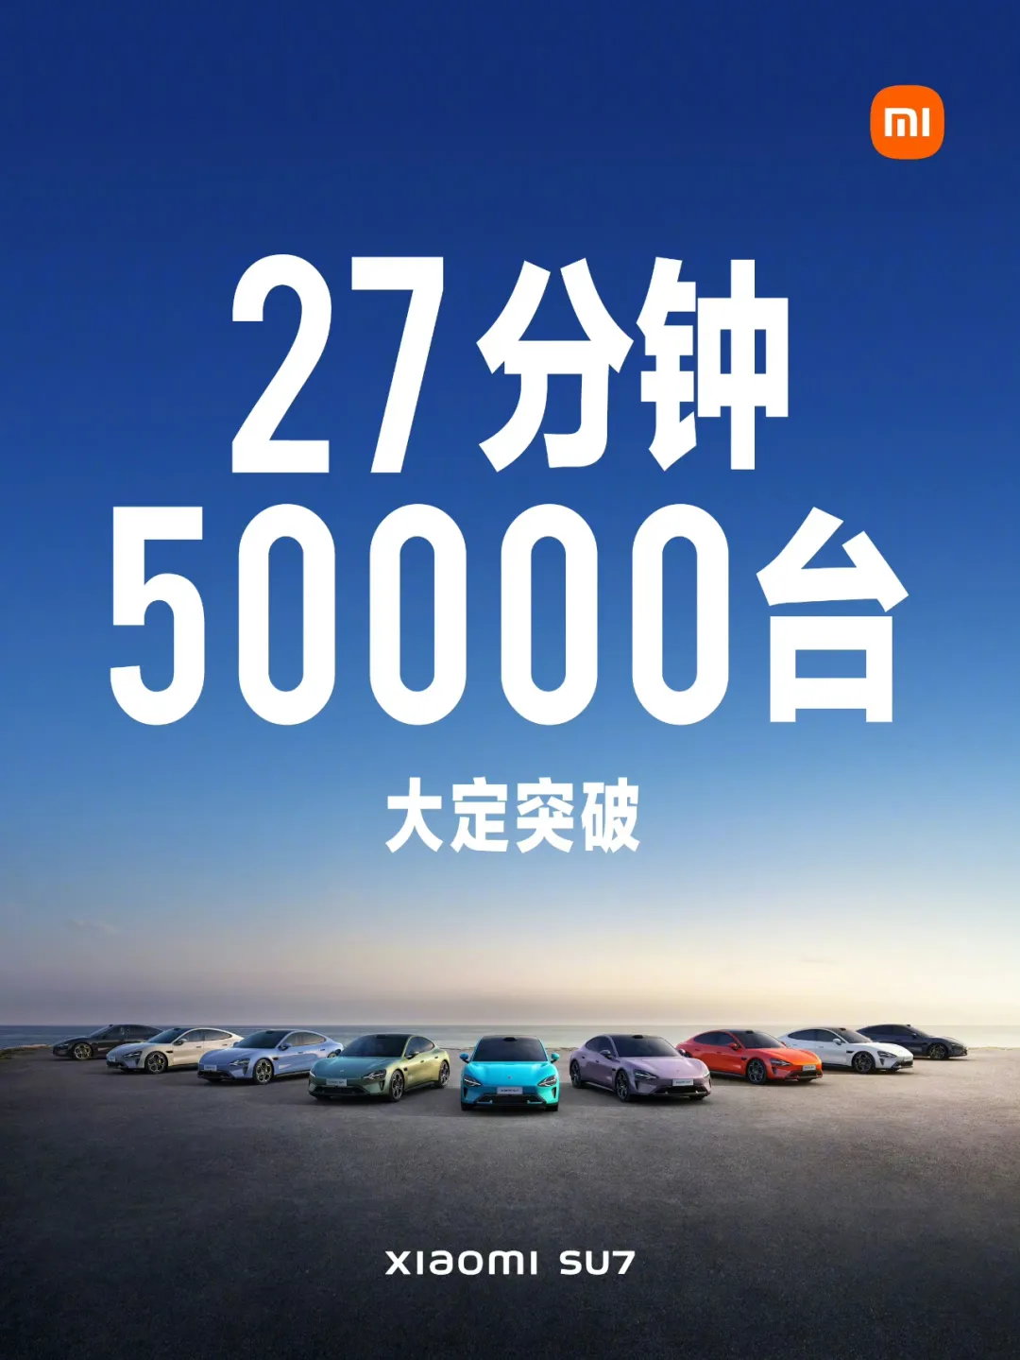
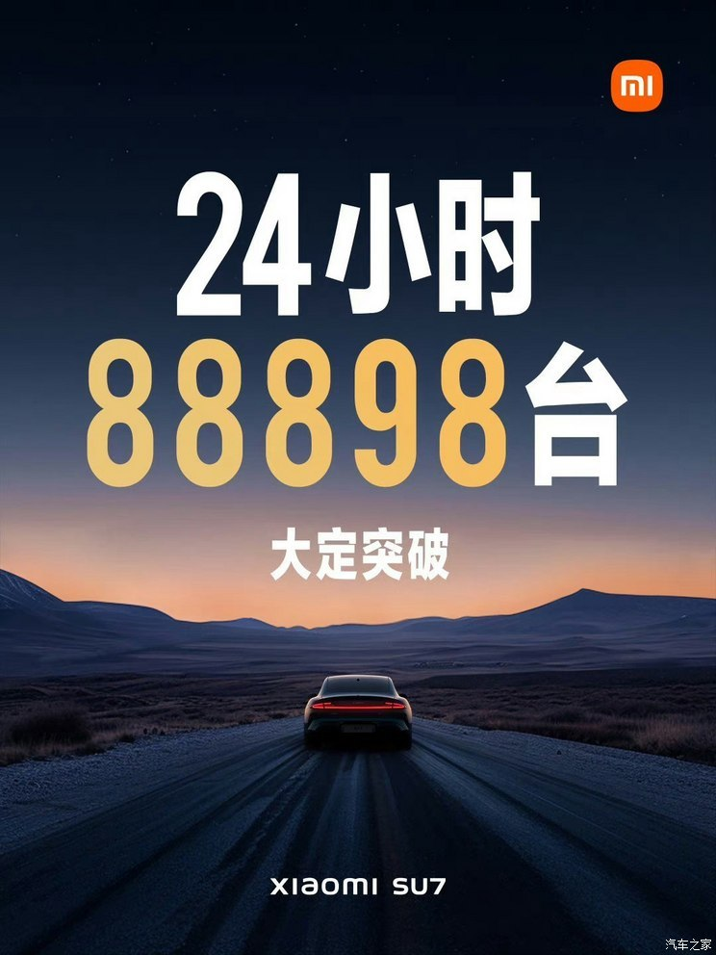
Desperate-Level Launch Event

Slide 9
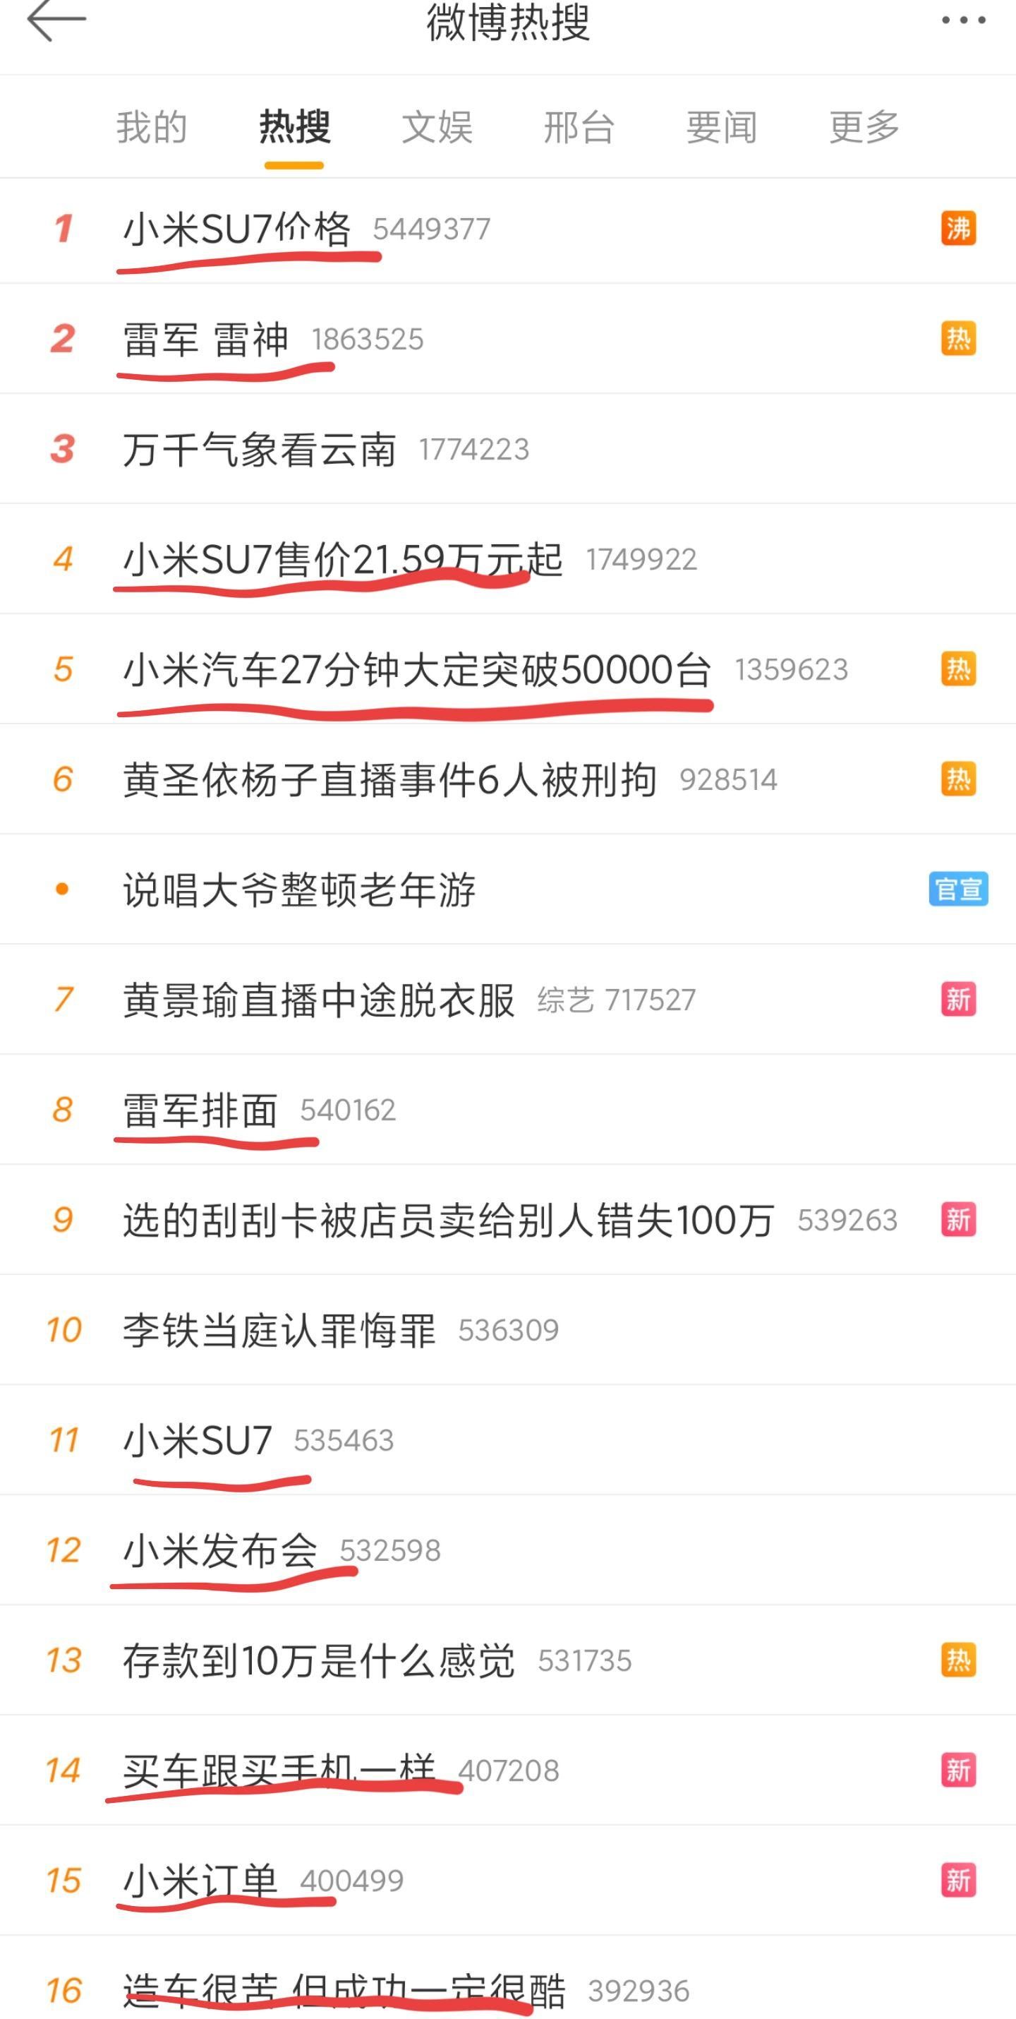
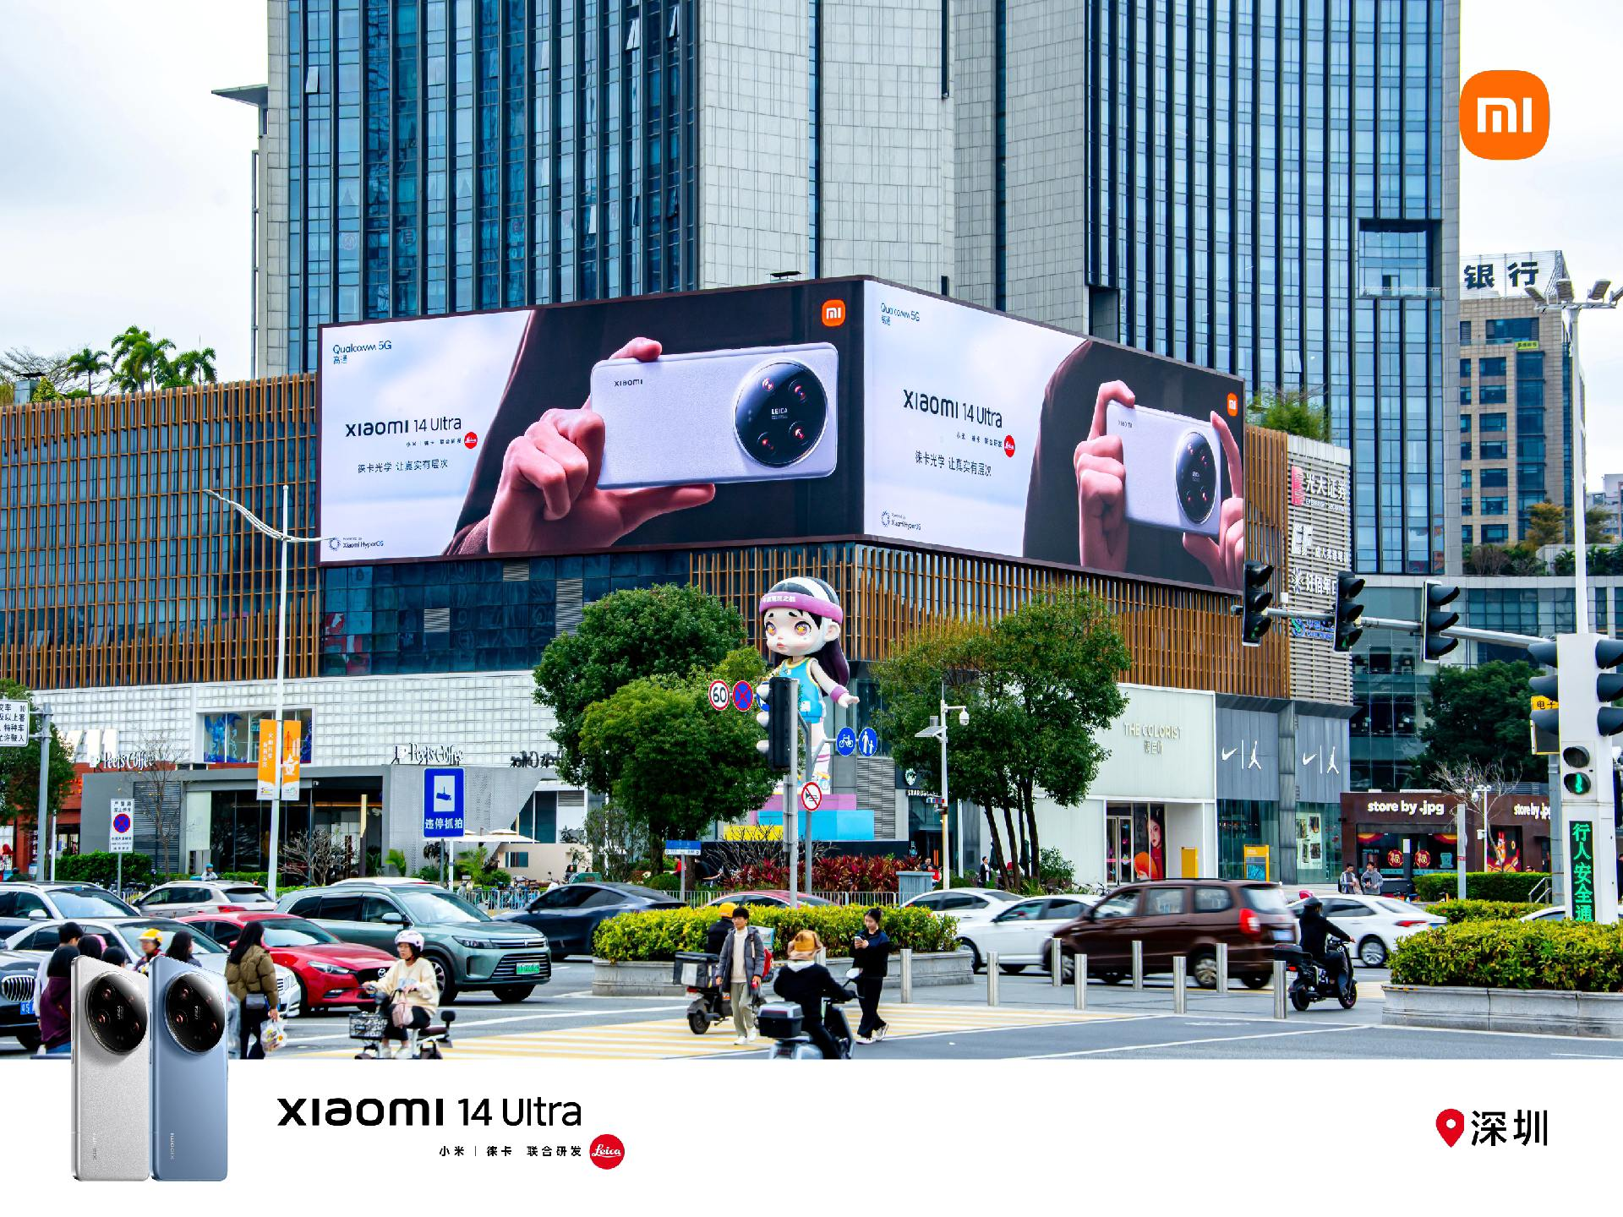
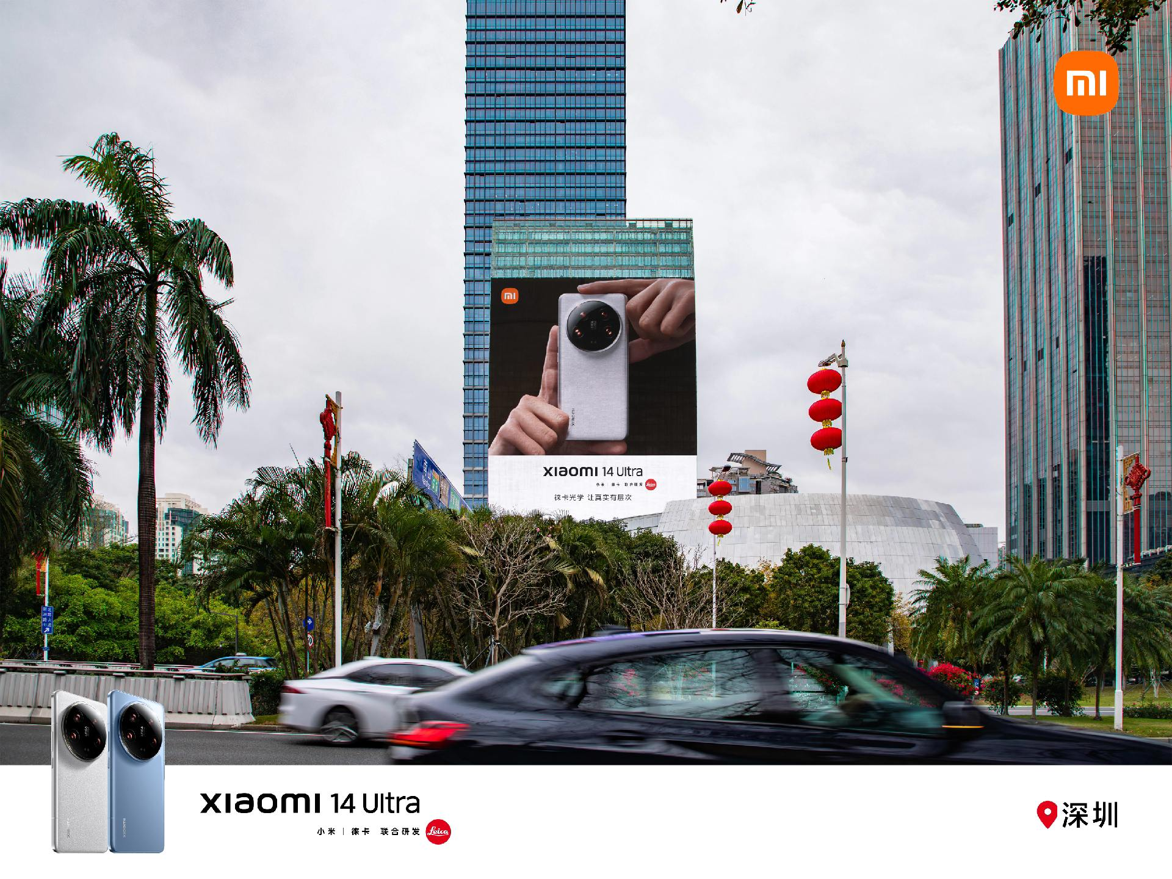
Desperate-Level Launch Event
Creating a Hot Topic
Investing in Hard Advertising
Utilizing Influencers for Promotion

Slide 10
Price Expectation
03

Slide 11
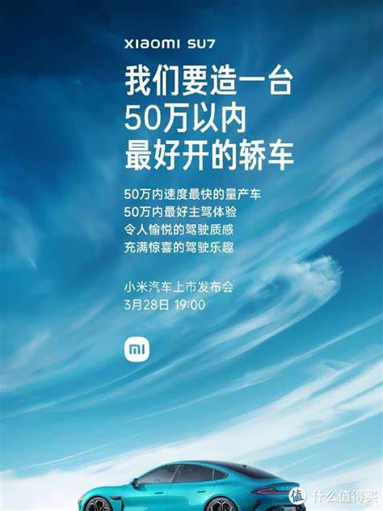
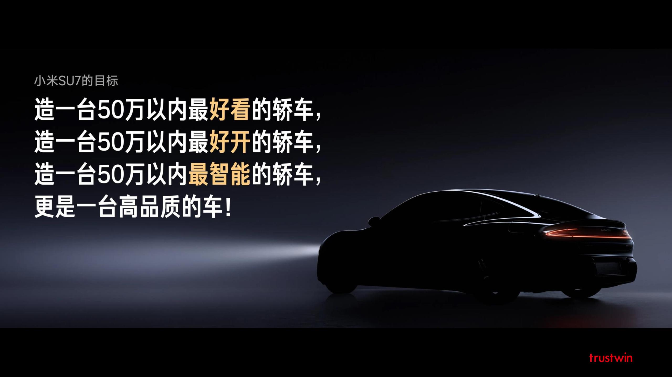
Price Expectation

Slide 12
Making people perceive the selling points
04

Slide 13
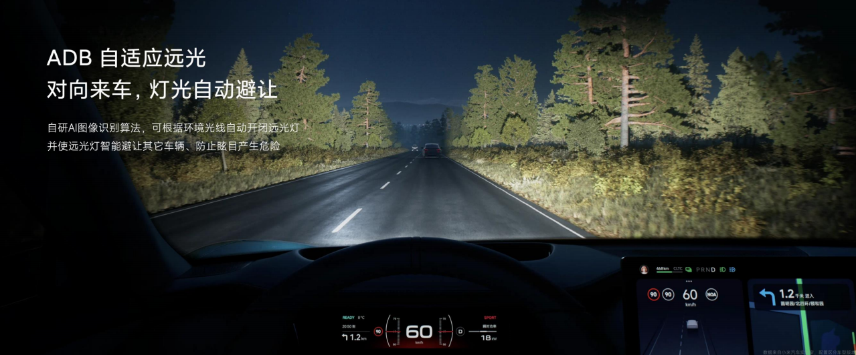
Making people perceive the selling points

Slide 14
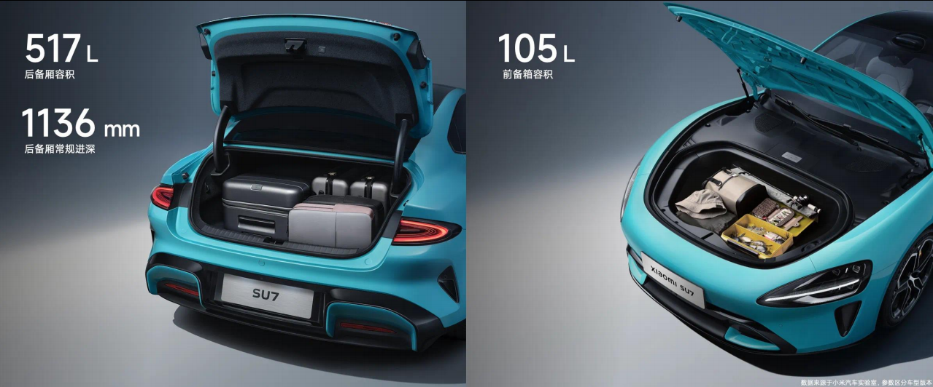
Making people perceive the selling points

Slide 15
In summary, these subtle marketing strategies have made Xiaomi increasingly powerful.

Slide 16
THANKs

